Slide 1


Data Analytics

Slide 2


Today’s Agenda
Project Recap
To provide a high-level overview of the business problem we're tackling and the precise requirements, we will provide a summary of the entire project.
Problem
We will get into the particular issue that the Data Analytics team has been concentrating on and provide some context for why this is such a significant issue.
The Analytics Team
I'll start by outlining the issue and then discuss the team that is in charge of handling this assignment on our end.
Process
After that, I'll go into the general steps we took to do this assignment so you can fully understand how we approach tasks of this nature.
Insights & Summary
Lastly, I will review all significant findings and offer them as a collection of understandings and illustrations from our

Slide 3


"Social Buzz" is a rapidly expanding unicorn in the technology space that needs to quickly adjust to its global reach.
Accenture has started working on the following activities during a three-month POC :
An examination of Social Buzz's use of big data
Strategies for a prosperous initial public offering (IPO)
An examination to determine the top 5 content categories on Social Buzz
Project Recap

Slide 4


Problem
In recent years, the customer has grown to an enormous extent, and they lack the internal resources to manage it.
Every day, Social Buzz receives over 100,000 posts, totaling 36,500,000 posts annually. Since all of the content is unstructured, it might be challenging to make sense of it all.
Determine the specifications that must be fulfilled for this project.
Combining tables from the sample data set
An analysis of their content categories that identifies the top five with the highest total popularity

Slide 5



Andrew Fleming
Chief Technical Architect
The Analytics Team
Marcus Rompton
Senior Principle
Priyanka Singh
Data Analyst

Slide 6



Process
Understanding Data – Did some review of the provided data sets to understand what would be needed from the data
1
Data Cleaning – Clean the data sets by removing null values, removing outliers for accurate data analysis
2
Data Modelling- Joined the three datasets for a comprehensive dataset for analysis
3
Data Analysis- With the help of Power BI, I analyzed the data to find the required insights and answer the stakeholder question
4
Uncover Insights- Dug deeper into the data to uncover more usefull insights for more questions the stakeholder might have
5

Slide 7


Insights
Unique Categories
Category With Highest Score
Month with
Most Posts
Animals
16
75K
JANUARY

Slide 8


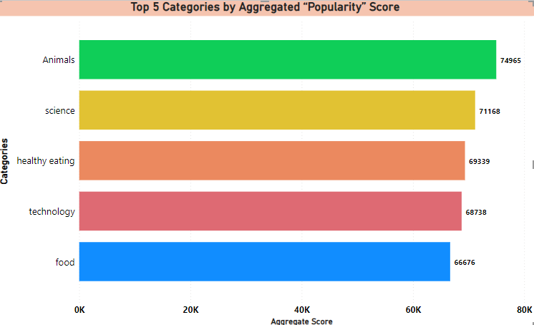

Slide 9
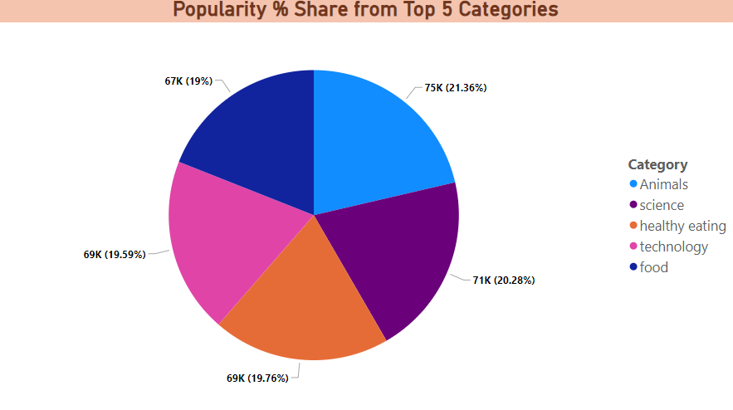

Slide 10
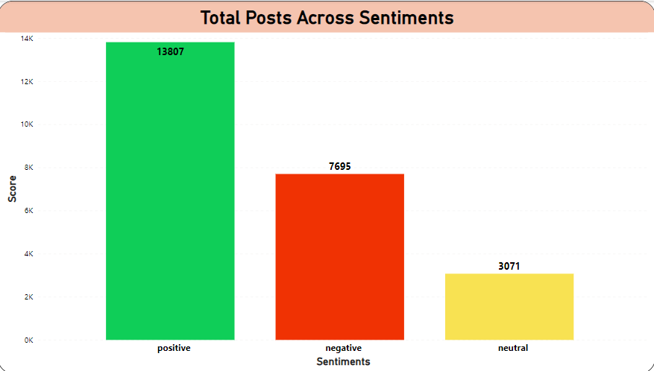

Slide 11

ANALYSIS
Animals and science are two of the most popular content categories, this shows that people enjoy “real-life” and “factual” content the most. So I would recommend that you keep creating more contents relating to these two categories.
INSIGHT
Summary
Food is a common theme with the top 5 categories with “Healthy Eating” ranking as one of the highest. This may give an indication to the audience within your user base. You could use this insight to create a campaign and work with healthy eating brands to boost user engagement.
NEXT STEPS
It should come as no surprise that technological content is among the top categories given the advancement of technology. It indicates that users like your technological material. Working with some of the biggest digital companies in the world is something I would suggest doing because it would undoubtedly increase user engagement.

Slide 12

Thank You!
ANY QUESTIONS?

